Slide 1


MINISTRY OF HEALTH
WEBSITE
Here is where your presentation begins

Slide 2

Team members
Jessica Safwat Sara Hossam Mariam Saad Mariam Alaa Mariam Reda Nourhan Abdelghany

Slide 3
01
PROJECT GOALS
02
PROBLEMS
TABLE OF CONTENTS
03
SOLUTION
04
SNEAK PEAKS
TOOLS USED
05

Slide 4
PROJECT GOAL
Providing more services for Egyptian citizens on Ministry of health website that would find a solution for their problems.

Slide 5
01
02
03
04
PROBLEMS
05
Getting wrong medical information from untrusted websites.
Citizens stuck in crowding hospitals during booking and waiting for clinics.
Citizens don’t know when they should make PCR.
Citizens don’t find medicine in nearby stores.
Citizens can’t contact directly with doctors for urgent situations.
06
Mothers don’t know the right times of their children vaccine.
07
Citizens didn’t know about medical initiatives done by ministry.

Slide 6
ONLINE MEDICAL CONSULTANT
ONLINE CLINICS BOOKING
SOLUTION
ONLINE DRUGS ORDED
COVID’19 ONLINE SURVEY
Online medical consultant for nutrition and general instructions in all medical fields from trusted doctors.
Online booking for clinics instead of waiting in hospitals and causing crowding and wasting time.
Ordering drugs and medicine online from the website instead of going to many pharmacies to find desired drug.
Online survey for Covid’19 symptoms to help citizens for deciding to go for test or not.

Slide 7
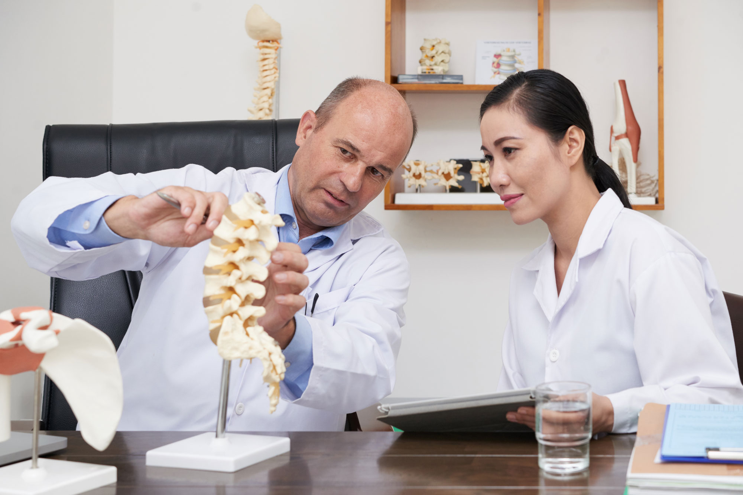
SOLUTION
MEDICAL INITIATIVES
VACCINE CONSULTANT
CHAT SYSTEM
Detailed advertisment about medical initiatives done by ministry of health for citizens.
The website help mothers to search by their children age to know when to go for their children’s vaccine
The website allow the oppurtinity for citizens to chat with trusted doctors form all the medical fields in urgent situations

Slide 8
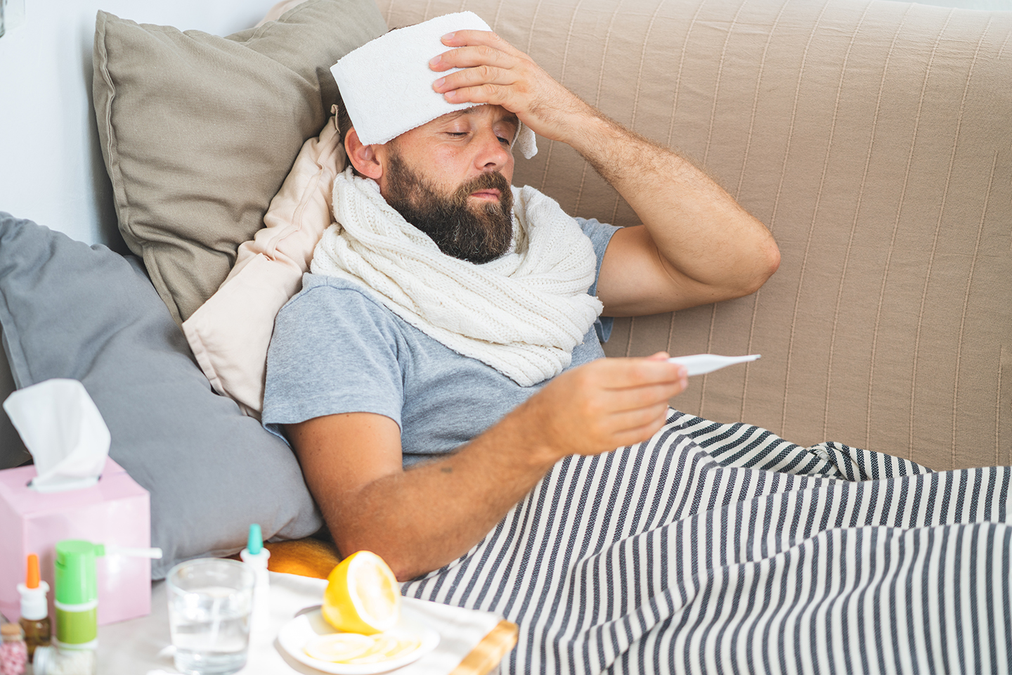
NOW
People get wrong instructions and infomation from untrusted helathcare websites.

Slide 9
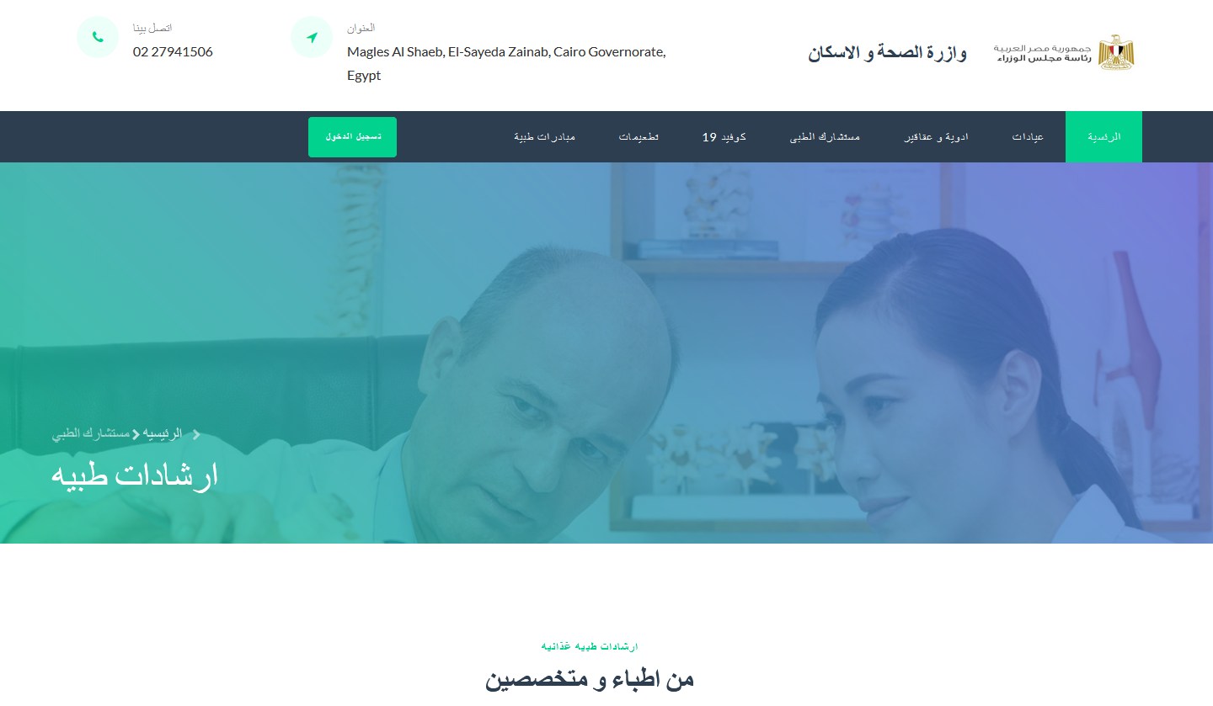
FUTURE

Slide 10

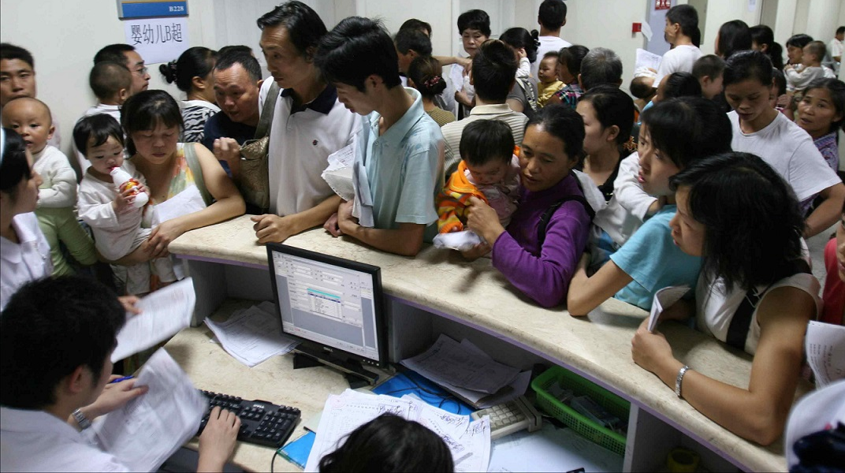
People stuck in crowded hospital’s receptions while waiting for their turn in clinics.
CLINICS BOOKING

Slide 11
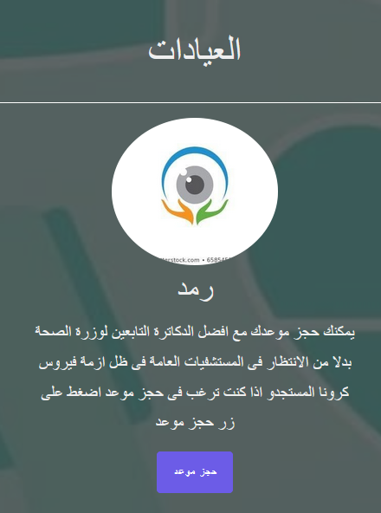
ONLINE CLINICS BOOKING
The website allow people to book the desired clinic and get thier turn number and their exact time to go in.

Slide 12


WHEN TO GO FOR PCR TEST?

Slide 13

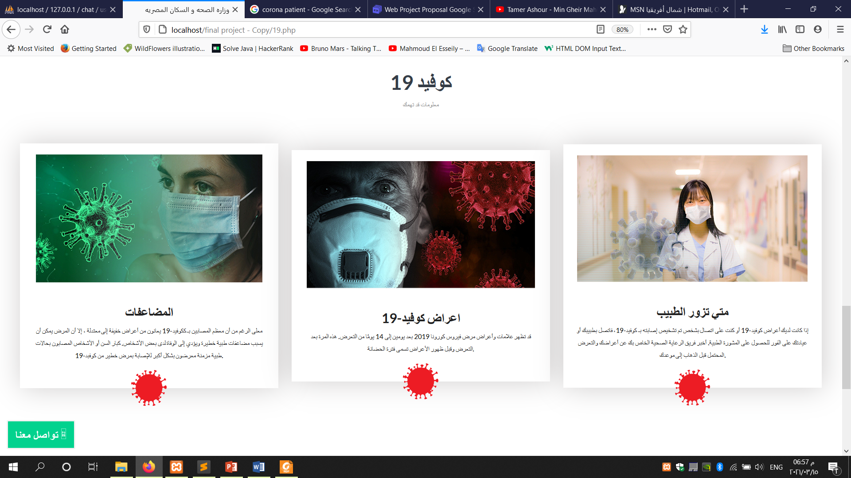
MAJOR REQUIREMENTS
01

Slide 14
Can’t find medicine in nearby stores.

Slide 15
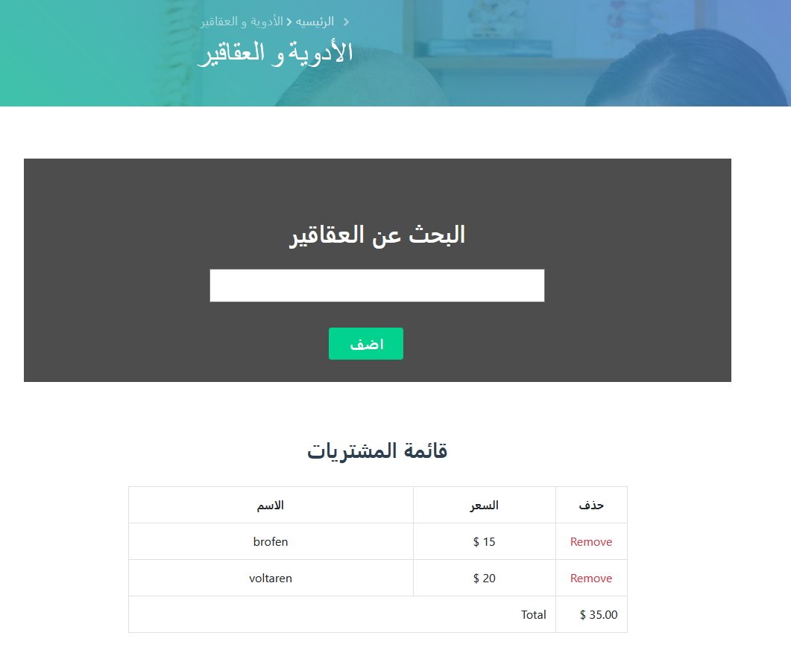
ORDER DRUGS ONLINE

Slide 16

Mothers don’t know the right time of their children vaccine.

Slide 17
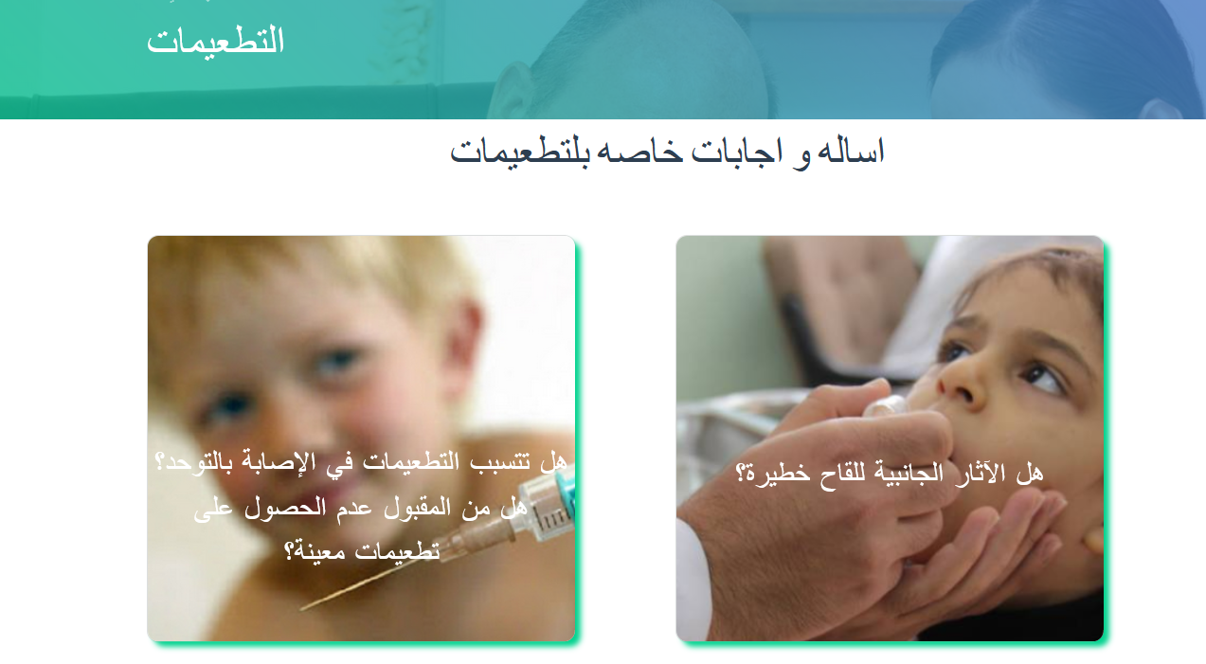
Search by your children age to get the right time of vaccine

Slide 18
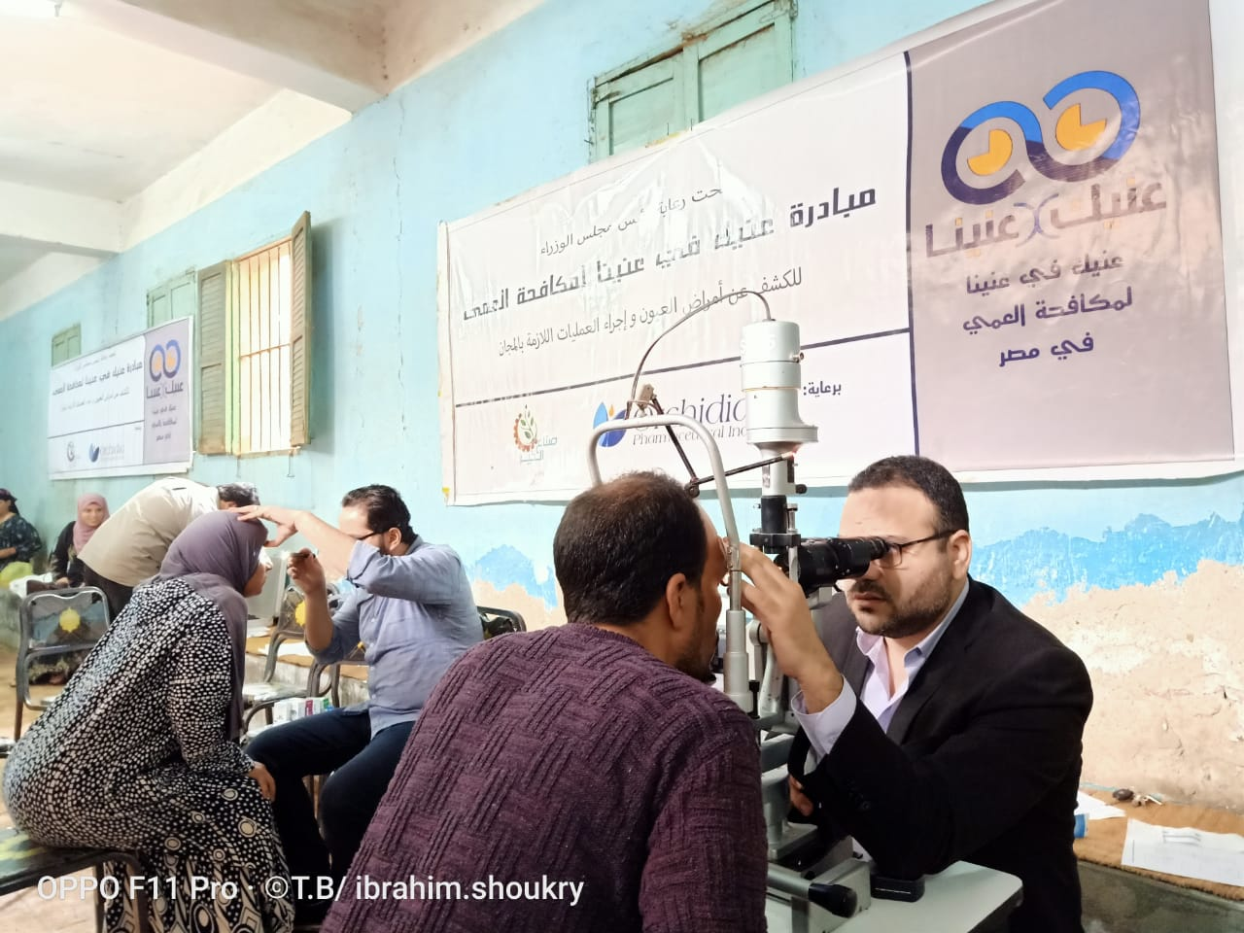
Citizens didn’t know about medical initiatives done by ministry.

Slide 19
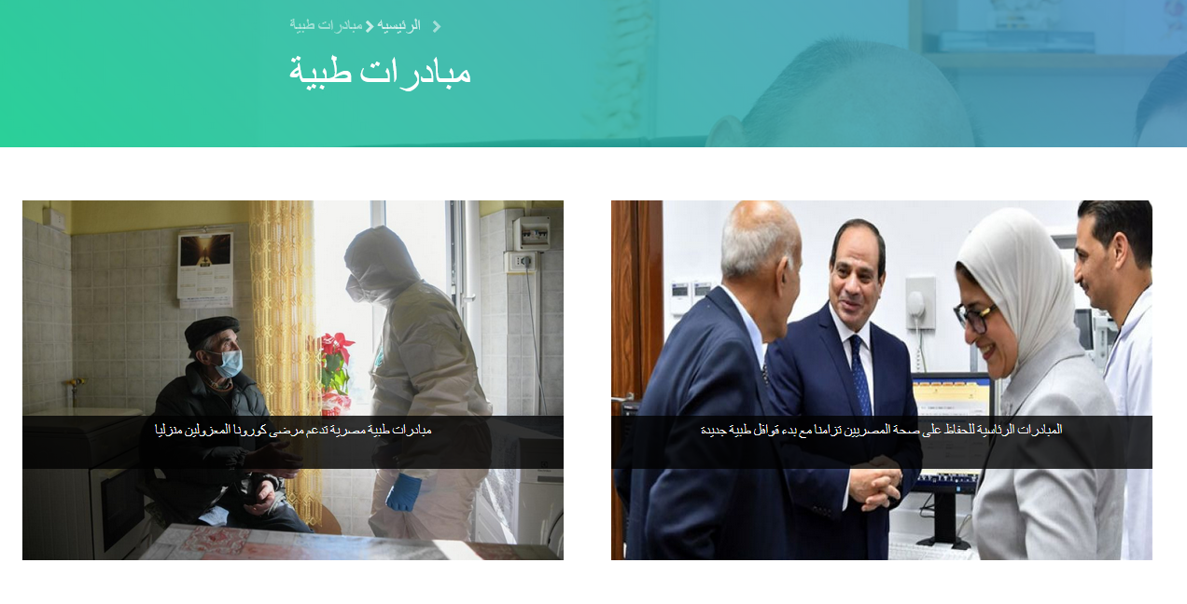
Detailed advertisment about medical initiatives

Slide 20
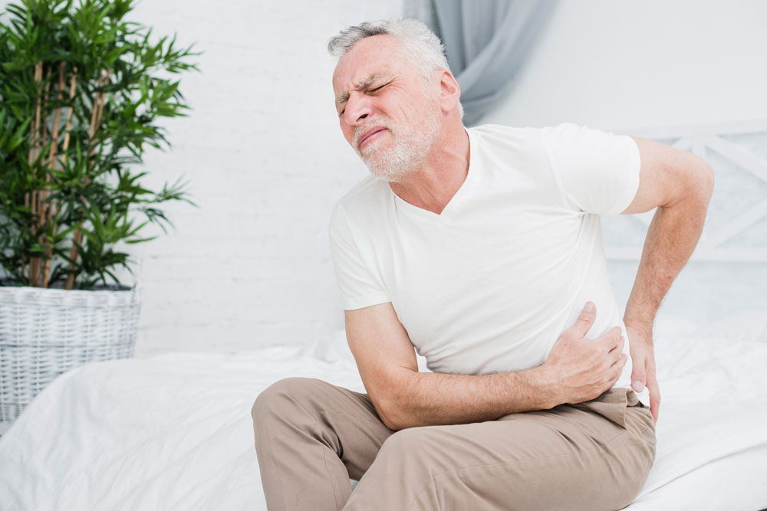
Citizens can’t contact with trusted doctors in urgent situations

Slide 21
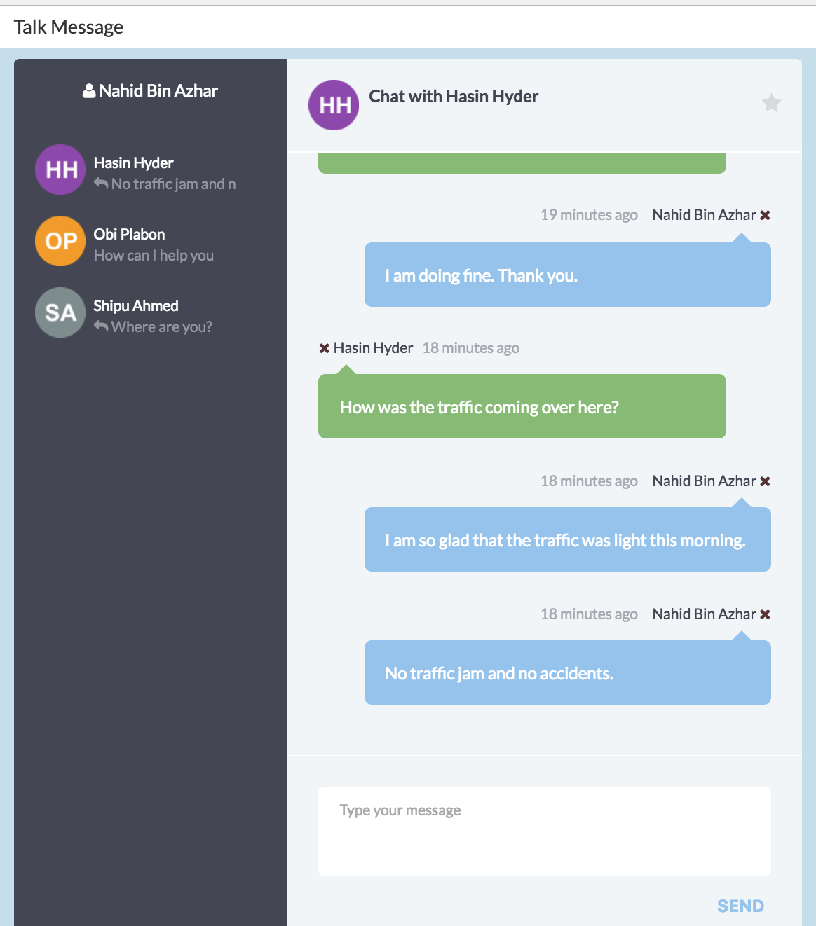
Online chat with doctors from all medical fields

Slide 22
HTML
CSS
TOOLS USED
PHP
MYSQL

Slide 23
Thank you

